Slide 1
组件模型
C/C++
python
Simulink/LabView
Debugger
编程语言
IEC
Java
JavaScript
基于类ObjectServer的动态加载、卸载和更新
组件加载签名认证
变量和数据区域的（跨RTE）映射
（跨RTE）接口调用
DDS消息总线（路由）
可靠性（冗余和高可用）
通讯协议
CANOpen
TCP/IP
UDP
Modbus
OPC UA
EAP(Beckhoff)
Linux | RT Linux | Linux+Xenomai | ucLinux |
Win CE | Win 10 | Vxworks（Reworks）| QNX
操作系统
x86
ARM
A8/A9/
A53/M7
MIPS
(龙芯)
硬件平台
现场总线
EtherCAT
Ethernet
profinet
profibus
CAN
RS485/232
KNX

Slide 2
1.元模型和组件分类
嵌套、系统功能、调用方式（周期）
4.组件安全状态机
组件行为协议，接口绑定委托检查等
6.组件间通信
所有组件面向虚拟总线构建交互端口，根据位置选择最优通信路径
2.端口分类
根据交互方式，require/provide，
memory mapping，non-functional
5.组件生命周期管理
基于Component Manager的组件加载、卸载、动态更新
7.高可用
计算节点故障时的组件迁移（冗余）方案
3.组件资源描述
（静态）内存分配，特定IO等
Device 1
Device 2
Device 3
Device 0
Resource constraint
Component Manager
Component Manager
Component Manager
Component Manager
组件虚拟总线
共享内存
UDP
RTOS
RTOS
RTOS
RTOS
Hardware
Hardware
Hardware
Hardware

Slide 3
计算节点 1
计算节点 2
计算节点 3
硬件
约束
Component Manager
Component Manager
Component Manager
组件虚拟总线
共享内存
UDP
RTOS
RTOS
RTOS
Hardware
Hardware
Hardware

Slide 4
组件分类
Composite Components：根据是否有子组件分类
Basic Components ：系统基础功能组件
Passive Components：被动调用还是周期执行并能创建线程（task）
Specific IO Components
DDS Components

Slide 5
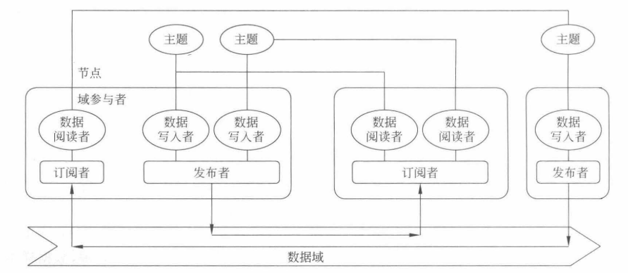
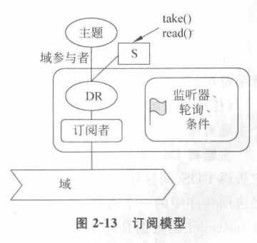
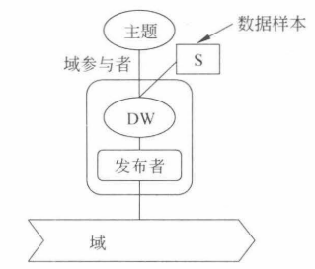

Slide 6
IDL
Request
Topic
Input Area
Topic
input
input
Cyclic
Task
Cyclic
Task
output
output
Reply
Topic
Output Area
Topic
Component A
filter
Component B
Component A
Component B
requester
replier
Component B
Data Flow
Topic
Event Trigger
Topic
filter
Component A
Component B
Component A
listener
Component C
sender
receiver
trigger
listener

Slide 7
CMC
BSC
PAC
Component
Manager
Component
Basic
Service
Component
Pluggable
Application
Component
Application Channel
Pre-defined
Local Channel
Manager Channel

Slide 8
Context 1
Context 1
Context 2
Context 2
Context 3
Context 3
Control port
Common port
Component
Manager
Cyclic port
DDS port
RTOS
Hardware
现场总线
Ethernet Adapter
RT-task Server
IO Manager

Slide 9
CH_INIT_SYSTEM：初始化系统组件
CH_INIT：初始化其他组件和其局部变量
CH_INIT2：初始化完毕，可使用接口，如创建event
INIT
由于一个module被创建后立刻在IP过程中进行实例化，所以一般module不会停在INIT状态
CH_INIT3：初始化完毕，可使用接口，如event注册
IP
在Objectserver中注册
实例化，参数初始化
分配系统资源（内存等）
action保留，资源释放，
在ObjectServer中删了自己
CH_INIT_SYSTEM_TASKS：启动task（IEC应用必要的）
CH_INIT_TASKS：启动其余task（引导项和PLC task）
PREOP
所有module创建完成，但模块之间的还未建立任何连接
CH_INIT_COMM：启动level7 server和通信
action保留，资源释放
通过objectserver获取其他module的objectID等信息并建立连接
此过程由configurator触发并可由父模块进行传参
CH_INIT_FINISHED：启动完成
PS
CH_COMM_CYCLE (hook)：operating mode
SAFEOP
CH_EXIT_COMM：所有level7 server关闭通信通道
进入real-time context
module之间可以互相注册并申请资源（如实时task）
CH_EXIT_TASKS：除了IEC应用所需task，终止其他task
SO
action保留，资源释放
CH_EXIT_SYSTEM_TASKS：终止所有task
OP
CH_EXIT3：移除注册和组件间依赖关系
CH_EXIT2：释放在CH_INIT2中所占用的局部资源
CH_EXIT：释放所有局部资源并析构(deinitialize)组件
CH_EXIT _SYSTEM2 ：析构(deinitialize)系统组件
CH_EXIT _SYSTEM：析构系统组件随后卸载组件

Slide 10
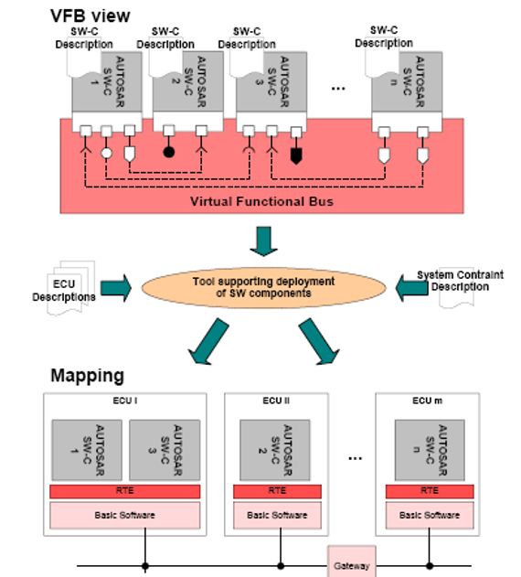
App
TC
Runtime system
OS

Slide 11
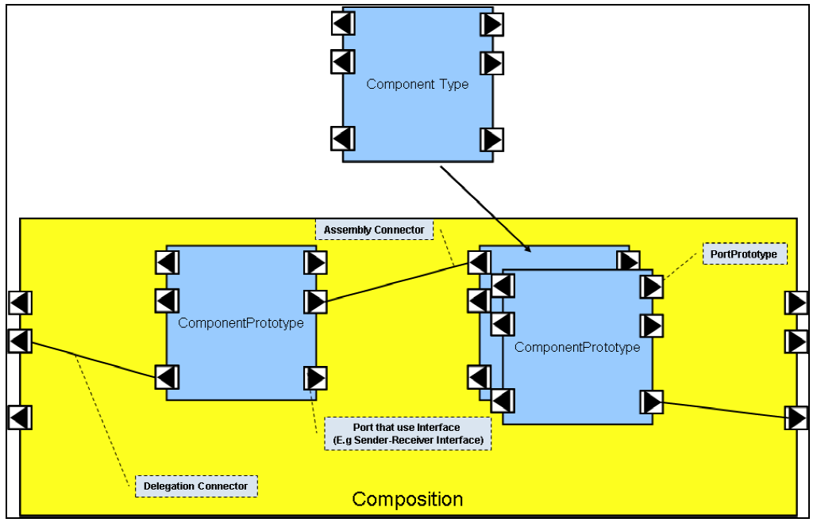
Type-Prototype Pattern

Slide 12
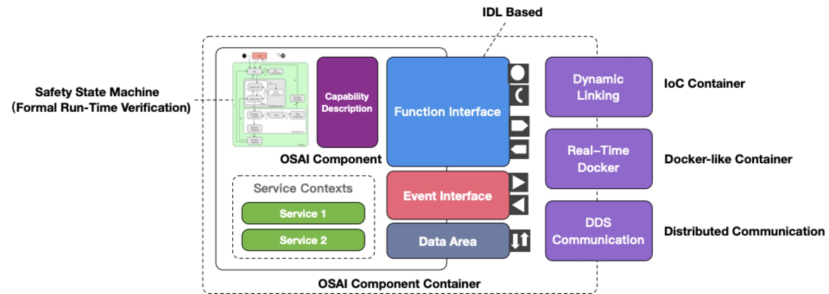

Slide 13
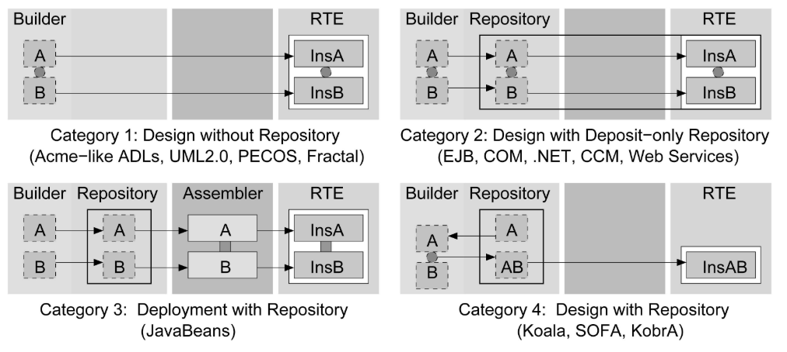
Life Cycle
Design Phase
Deployment Phase
Run-time Phase
Object−oriented Programming Languages
Programming Languages with IDL mappings
Architecture Description Languages
Syntax
Classes
Objects
Architectural Units
Semantics
Taxonomy
Composition

Slide 14
Port
Require port
Provide port
Require/Provide port
 | Synchronous | Asynchronous
Control-based | Request-reply interface | Event-trigger interface
Data-based | Cyclic synchronous interface | Send-receive interface
Interface
 | Intra-container port binding | Inter-container port binding
request-reply interface
send-receive interface
cyclic synchronous interface
event-trigger interface
Port Instance
Service
Passive
Periodic

Slide 15
Design
Deployment
Run-time
Builder
Repository
Assembler
Distributed RTE
deposit
compile
instantiate
A
A
A
insA
A
component
B
B
insB
A
component(binary)
retrieve
insA
component
instance
C
C
B
insB
A
D
D
D
insD
component container
B
deposit
CD
CD
insCD
design phase composition operator
(composite)
deployment phase composition operator
(intra-container assemble)
run-time phase composition operator
(inter-container/run-time assemble)

Slide 16
Design Phase
Deployment Phase
Run-time Phase
Modeler
(OEM)
Builder
(Vendor)
Repository
(Vendor)
Object
Repository
(OEM)
Distributed
RTE
Hardware
Architecture
deposit
compile
instantiate
update
A
A
A
insA
insA’
Software
Architecture
B
B
insB
unload
CTR.xml
assign
merge
insB
IAD.xml
retrieve
C
C
CD
insCD
D
D
E
insE
Third-party
Software
load
deposit
CD
insF
component
(binary)
component
instance
composite
instancebus
A
component
A
insA
CRD: Component Template Repository
IAD : Instance Architecture Description

Slide 17
Application
State Machine
Composite
Delegate
Assemble
Delegate
DataArea
Atomic
Function
Service
Event

Slide 18




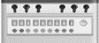

Slide 19
Component Type
Atomic Component Type
Composite Component Type
Atomic/Composite Component Type References
State Machine
AC Type Reference
Service
Interfaces

Slide 20
CoETransport_1
MotionControl
Visualization
AC_Instance
AC_Instance
AC_Instance
P_MoveAxisbyPos
R_MoveAxisbyPos_1
PR_AxisPosSync
P_ GetAxisPos
R_ GetAxisPos _1
PR_AxisPosSync
CoETransport_2
NCControl
R_ SendSignalHandler
AC_Instance
AC_Instance
P_MoveAxisbyPos
R_MoveAxisbyPos_2
P_SendSignal
P_ GetAxisPos
R_ GetAxisPos _2
OSAI Connection

Slide 21
CoETransport
Composite_AC_Type
P_LifeCycle
CANOpenProtocolSuppport
EtherCATMaster
Atomic_AC_Type_Ref
Atomic_AC_Type_Ref
P_ConfigMode
P_ConfigOPMode
P_ECConfigDC
P_ConfigDC
R_WriteSDO
P_WriteSDO
R_ReadSDO
P_ReadSDO
P_MoveAxisbyPos
P_SetPos
P_ GetAxisPos
P_GetPos
R_ECSend
R_ECReceive
Delegation
Binding
R_EthSend
R_EthReceive

Slide 22
Node 1
Node 2
Container A
Container B
Container C
Dynamic linking
CM
BC
AC
CM
BC
AC
CM
BC
AC
intra-node communication
handled by middleware
(shared memory)
inter-node communication
handled by middleware
(field bus)
OS
OS
Hardware
Hardware
CM : component manager；BC : basic component；AC : application component

Slide 23
Node A
Node B
Node C
Dynamic
Instance
Space
PAC
LAC
UDB
Low-level RTE
Run-time
Support
Layer
OSAS
IAM
RT-Task
Manager
OSAS
IAM
Hardware (MCU)
Inter-node communication
via field bus
Intra-node communication
via shared memory
OS (real-time)
OS
Real-time task
Service
Hardware
Hardware
Other run-time supports
or specific drivers
IAM : Instance Adaption Manager
OSAS : Operating System Abstraction Server
PAC : Pluggable Application Component
LAC : Low-equipped Application Component
UDB : Unified Dynamic Bus

Slide 24
Node A
Node B
Node C
Contain-erized
Instance
Layer
PAC
LAC
UDB
Low-level RTE
Run-time
Infrastr-ucture
Layer
OSAS
CAM
RT-Task
Manager
OSAS
CAM
Hardware (MCU)
Inter-node communication
via field bus
Intra-node communication
via shared memory
OS (real-time)
OS
Real-time task
Service
Hardware
Hardware
Other run-time supports
or specific drivers
CAM : Component Adaption Manager
OSAS : Operating System Abstraction Server
PAC : Pluggable Application Component
LAC : Low-equipped Application Component
UDB : Unified Dynamic Bus

Slide 25
Node 1
Node 2
IoC Manager
IoC Manager
C
Python
Java
C
IEC
C
C++
intra-node communication
handled by middleware
(shared memory)
inter-node communication
handled by middleware
(field bus)
Low-Level Runtime(OS)
Low-Level Runtime(OS)
Hardware
Hardware

Slide 26
消息中间件
CM
CM
CM
OS
OS
Hardware
Hardware
Service
Function
Service
Event
Service
Data Area
Service
Atomic Component Type

Slide 27

Algo
HMI
CANopen
CANopen
IEC
EtherCAT
EtherCAT
Modbus

Slide 28
Routing
Local
Routing
Interface
Router
Message
Queue
Manager
Shared Memory
Manager
Event
Manager
Remote
Routing
DCPS Manager
Request
Topic
Input Area
Topic
Data Flow
Topic
Event Trigger
Topic
Reply
Topic
Output Area
Topic

Slide 29
1
2
3
9
INIT
LOADED
READY
ACTIVE
UPDATED
6
5
4
7
8
DELETED
DEACTIVE
BLOCKED
PARALLEL
组件实例化，参数初始化；组件通过Dynamic Linking加载，并在Component Manager注册其提供的interface
查询Component Manager，获取所需的interface，并建立组件间路由连接（Local routing, DCPS writer/reader）
Periodic service绑定task，并开始运行。
停止接收新的调用和通信，等待当前调用执行完成并返回。
调用执行完成，释放资源，解绑task。
注销Component Manager中注册的Interface，卸载组件。
阻塞新的调用和通信，等待当前调用执行完成并返回。
解绑task，更换新的component实例，将之前的引用重定向至新版本的组件，并重新建立连接
唤醒步骤⑦中阻塞的调用和通信，重新绑定task 并开始运行。

Slide 30
Node A
Node B
Node C
Topic 3-A
Data writer
Topic 3-B
Topic 2-A
Topic 3-A
Topic 2-A
Topic 3-A
Topic 3-B
Data reader
Topic 1-A
Topic 3-B
Topic 2-A
Topic 3-B
Topic 3-A
Topic 1-A
Topic 1-B
Topic 1-B
DCPS Manager(Basic Component)
DCPS Manager
DCPS Manager
Subscriber
Subscriber
Subscriber
Subscriber
Subscriber
Subscriber
Subscriber
Publisher
Publisher
Publisher
Publisher
Publisher
Publisher
Publisher
Channel 1 (Topic:1-A,1-B)
Channel 2 (Topic:2-A)
Channel 3 (Topic:3-A,3-B)
组件虚拟总线

Slide 31
JavaBeans
EJB
COM
.NET
CCM
Koala
SOFA
KobrA
ADLs
UML2.0
AUTOSAR
PECOS(8)
Pin
Fractal
µ-Kevoree(5)
TDL(9)
FORMULA(10)
Rubus(12)
IEC 61449(14)
ICSCM
 | DR | RR | CS | DC | CP | CR

